Slide 1


Title of the Project
Review-I
AY 2025-26
Capstone Project – Introduction (PROJ2999)
GITAM (Deemed-to-be) University
Department of Electrical Electronics and Communication Engineering
Project Team:
SOMANATH K
C BHAVANI SHANKAR
SAITEJA K
Project Mentor:
Dr. T Nagarjuna
Project In-charge:
Dr. Kshitij Shakya
www.gitam.edu

Slide 2
Objective and Goals
Objective
The main objective of this project is to simulate Vehicle-to-Vehicle (V2V) and Vehicle-to-Infrastructure (V2I) communication using 5G technology and to analyze the latency performance in different scenarios. The project aims to study how 5G enables reliable, high-speed, and ultra-low latency communication, which is essential for safety-critical applications such as collision avoidance, traffic management, and autonomous driving. The goal is to develop a simulation model that demonstrates how vehicles and infrastructure exchange data in real time, evaluate latency under varying network and traffic conditions, and highlight the advantages of 5G over previous wireless technologies. Through this work, the project provides insights into how 5G can enhance the efficiency, safety, and reliability of future intelligent transportation systems (ITS).
Goals
Main Goals
Simulate V2V and V2I communication using 5G.
Analyze latency in different traffic conditions.
Demonstrate real-time data exchange for safety.
Compare 5G with older communication technologies.
Additional Goals
Provide insights for autonomous vehicle applications.
Study reliability and efficiency of 5G networks.
Suggest improvements for future smart mobility solutions.

Slide 3
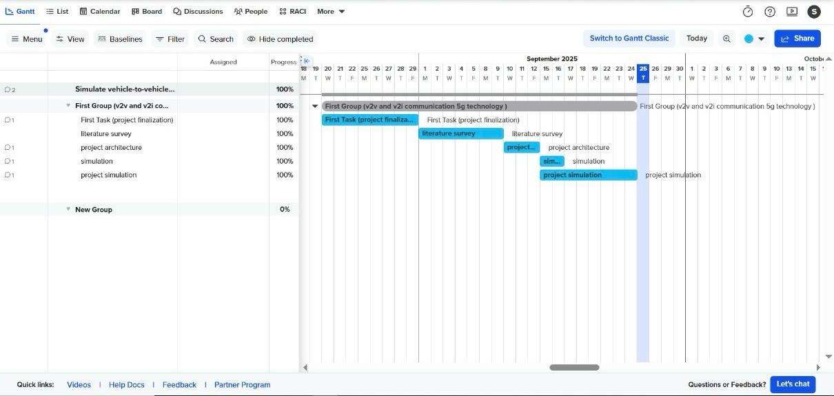
Project Plan (Clearly mention milestone for objectives under each reviews)
Gant Chart - Milestones and Activities
high-level phases(ordered):
1. Project setup & scenario definition
2.Vehicle model initialization & mobility simulation
3.5G communication system configuration (baseline)
4.Baseline V2V message exchange (conventional RF)
5.5G-enabled V2V simulation
6.Sensor fusion and radar integration
7.Evaluation & results analysis
8.Final deliverables, documentation & demo

Slide 4
Literature Survey
Key Publications
5G Vehicular Networks: A Survey Summary: Provides a comprehensive overview of 5G-enabled vehicular communication, including V2V and V2I use cases, network architecture, and performance metrics like latency, reliability, and throughput.
Ultra-Reliable Low Latency Communications in 5G: Principles and Applications Summary: Discusses the fundamental principles of URLLC (Ultra-Reliable Low Latency Communication) in 5G and its role in enabling real-time vehicular communication and safety-critical applications.
Latency Analysis of 5G-Based V2V and V2I Communication Summary: Focuses on latency performance evaluation in vehicular scenarios, presenting simulation and analytical models to study end-to-end delays.
5G Technologies for Intelligent Transportation Systems Summary: Reviews the role of 5G in ITS, highlighting its advantages for traffic management, autonomous vehicles, and enhanced safety through low-latency communication.
Key Resources – Whitepaper| Application Notes | Datasheet| Others
MathWorks Whitepaper on 5G Toolbox: Explains how MATLAB can simulate 5G NR systems, including URLLC for V2X applications.
Qualcomm 5G Latency Analysis Whitepaper: Provides insights into low-latency communication for vehicular safety systems.
Existing Implementations – Products| Opensource| GitHub etc
MATLAB 5G Toolbox – For designing and simulating 5G NR V2V and V2I communication.
MATLAB Vehicle Dynamics Blockset – Models vehicle motion and mobility for V2X simulations.
MATLAB Simulink – For integrating vehicle models, 5G network, and latency analysis.

Slide 5
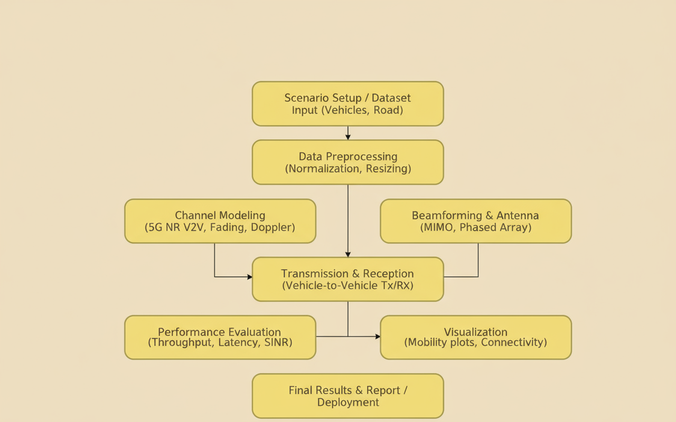
Architecture

Slide 6
Use Cases
Use Cases
TC-01:
Simulation Setup → MATLAB 5G Toolbox loaded, network parameters initialized successfully.
TC-02:
Vehicle Mobility → Vehicle positions update correctly using MATLAB Vehicle Dynamics Blockset.
TC-03:
V2V Communication → MATLAB simulation shows messages transmitted between vehicles, packet loss < 5%.
TC-04:
V2I Communication → Vehicles connected successfully to simulated infrastructure (RSU/base station) in MATLAB.
TC-05:
Latency Measurement → End-to-end latency calculated using MATLAB functions ≤ 10 ms for safety messages.
TC-06:
Throughput Calculation → MATLAB computes throughput ≥ 95% of configured 5G bandwidth.
TC-07:
Reliability Testing → MATLAB simulation shows packet delivery ratio ≥ 90% under different traffic densities.
TC-08:
Visualization → MATLAB plots display vehicle positions and communication links clearly.

Slide 7
Testing
Test Cases
TC-01:
Latency Metric → MATLAB calculates latency values correctly for all message types.
TC-02:
Throughput Metric → Throughput measured in MATLAB matches expected results.
TC-03:
Packet Delivery Ratio (PDR) → MATLAB simulation shows PDR ≥ 90% in all scenarios.
TC-04:
Jitter Measurement → MATLAB computes jitter values consistently across multiple runs.
TC-05:
Reliability Metric → MATLAB simulation maintains reliability for safety-critical messages.
TC-06:
Comparative Analysis → MATLAB results show 5G latency lower than LTE/DSRC for identical setups.
TC-07:
Scenario Variation → MATLAB metrics update correctly for urban, highway, and dense traffic scenarios.

Slide 8
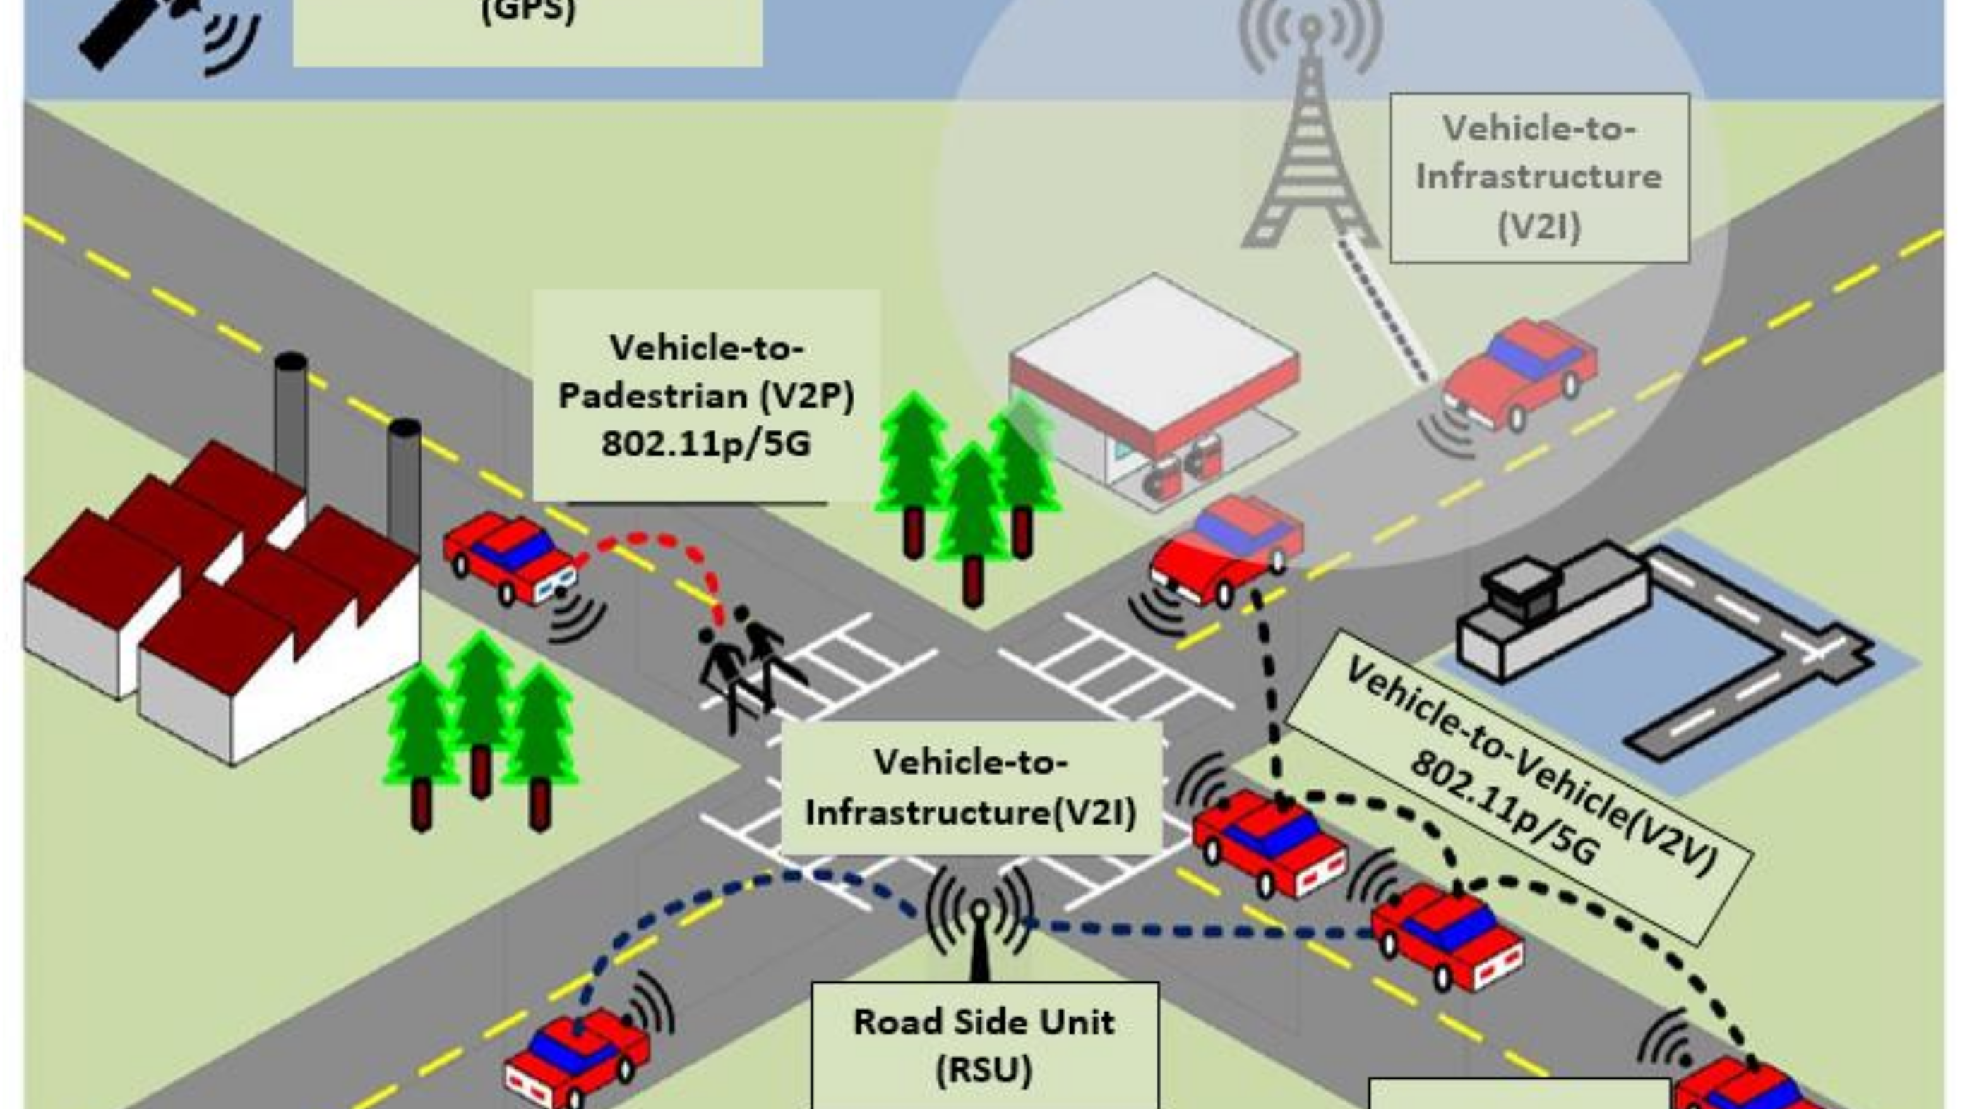

Slide 9
THANK YOU
Have a Great Day !

